Slide 1
Requirements from Molecular Spectroscopy Group (Indirect Geometry Neutron Instruments)
Sanghamitra Mukhopadhyay
General Requirements
Data Reduction
Data Analysis
Data Interpretation
Data Visualization
Short Term
  Data reduction and analysis using command line mode alongside with GUI
Interface routines to calculate VDOS from CASTEP, VASP, GAUSSIAN and nMoldyn outputs.
Medium Term
Reduction of diffraction data including calibrations for all indirect geometry instruments
Robust fitting routines including option of convolution with resolution function
Interface routines to calculate S(Q,ω), MSD etc from nMoldyn
Long Term
Improved statistical analysis routines and absorption corrections
Multiple scattering corrections
Interface routines with quantum chemistry software
3D plotting

Slide 2
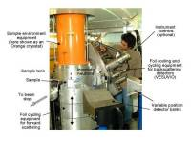
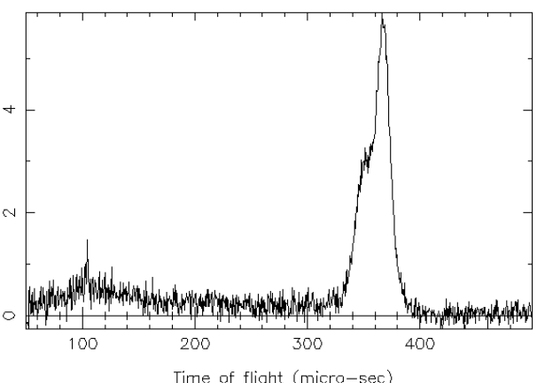
Requirements from eV Spectrometer VESUVIO
VESUVIO is a high energy spectrometer (eV range)
VESUVIO is our priority instrument, because only 25% of its requirements has been implemented on Mantid
  Data reduction
  Complete data reduction facility using both command line and GUI,
  Reduction of diffraction data including all detector banks
  Calibration, resolution, diagnostic routines
Data analysis
Fitting routines using mass selective convolution
Multiple corrections
Data interpretation
Interfacing with CASTEP, VASP for calculation of spectrum width
Data visualizations
Publication quality 2D and 3D plotting out of reduced and fitted data

Slide 3
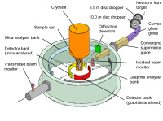
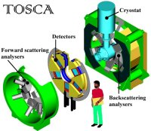
Requirements from Low and Intermediate Energy Spectrometers, IRIS, OSIRIS, TOSCA
IRIS and OSIRIS are low energy QENS spectrometer (80% implementation is complete)
TOSCA is intermediate energy neutron spectrometer (80% implementation is complete)
IRIS
  Data reduction
  Complete data reduction facility using both command line and GUI,
  Reduction of diffraction data including calibration
Data analysis
Fitting options using convolution with resolution data
Multiple corrections, absorption corrections
Statistical analysis
Data interpretation
Interfacing with CASTEP, VASP for calculation of VDOS (TOSCA), S(Q,ω), MSD (IRIS, OSIRIS) etc from nMoldyn
Data visualizations
Publication quality 2D and 3D plotting out of reduced and fitted data

